Slide 1
Internship project
Fiber Network Fault Detection and Performance Monitoring System
Name: Dhanvin kadiir
roll no: 231401022
Department of computer science and business systems
Rajalakshmi engineering college, chennai

Slide 2
Abstract
The project aims to design and develop a reliable system capable of detecting faults in optical fiber networks and continuously monitoring their performance parameters.
In large telecommunication infrastructures like BSNL, detecting a fiber break or degradation manually consumes significant time and resources.
This project focuses on automation to identify fiber faults, pinpoint the exact fault location, and assess the overall health of the network in real-time.
The system helps to minimize downtime, reduce operational costs, and improve customer service quality.
By integrating monitoring tools with optical devices and a centralized dashboard, the project demonstrates how network stability and efficiency can be enhanced using technology.

Slide 3
Introduction
Optical fiber networks serve as the backbone for high-speed data and voice communication in modern telecom sectors, and their reliability directly determines overall service quality.
Traditional fault detection methods depend on manual otdr testing and field engineers, which often result in long delays, higher maintenance costs, and frequent service interruptions.
With the rapid growth of data traffic and increasingly complex network topologies, real-time monitoring and automated fault management have become essential for telecom providers.
This project introduces a software-driven approach to detect and analyze fiber faults automatically, ensuring quick fault restoration and minimal human intervention.
The system integrates both monitoring hardware and software analytics tools to collect data, measure signal loss, and provide actionable performance insights.
The ultimate goal is to make bsnl’s optical fiber infrastructure more intelligent, efficient, and responsive to network issues, thereby enhancing customer satisfaction and operational reliability.

Slide 4
System Analysis
Existing System: Currently, BSNL relies on OTDR devices and field visits to detect fiber cuts or signal losses. Fault detection requires technicians to travel to multiple junctions, which delays restoration.
Limitations: Manual fault detection is slow, prone to human error, and lacks continuous monitoring. The absence of automated alerts leads to long downtimes.
Proposed System: The new system automatically monitors fiber link parameters such as signal strength, attenuation, and power levels.
It provides instant alerts when signal deviation crosses a threshold, ensuring early detection and faster repair response.
The system also stores historical data, allowing engineers to analyze performance trends over time.
Through automation, maintenance teams can respond proactively rather than reactively.

Slide 5
System Design
Network Devices
Data Preprocessing
ML Model
Fault Detection
Dashboard/ Alert System

Slide 6
System Implementation
The system was implemented using Python for backend logic, Flask for the web interface, and MySQL for data storage.
Data from OTDR or SNMP-based devices is collected and parsed into the system through an automated data acquisition module.
The web dashboard displays live statistics such as optical signal power, link uptime, and fault reports.
The system also generates notifications through email or SMS when a fault occurs, ensuring immediate attention.
Implementation was tested at BSNL RGMTTC, Chennai, using a simulated fiber loop setup.
During testing, multiple types of fiber breaks and signal attenuations were simulated to verify detection accuracy.
The setup proved efficient, reliable, and ready for field deployment on real network routes.

Slide 7
Performance Analysis
The system was evaluated based on parameters such as fault detection time, accuracy, and system response.
On average, the automated system detected faults 60–70% faster than traditional manual methods.
The accuracy rate in pinpointing the exact fault location reached about 95%, with very low false alarms.
Performance metrics like signal-to-noise ratio, attenuation rate, and uptime percentage were recorded and analyzed using graphical plots.
The data visualization feature helped engineers understand network behavior over different time intervals.
Overall, the project demonstrated a measurable improvement in network uptime and fault management efficiency.
The results confirm that the proposed monitoring system can significantly enhance BSNL’s operational performance.

Slide 8
Conclusion
The project successfully developed an automated system that detects fiber faults and monitors network performance efficiently.
It eliminates dependency on manual testing and enables real-time fault localization, reducing downtime drastically.
The results highlight how automation and data-driven decision-making can transform network maintenance in telecom environments.
The solution can be expanded to integrate with AI-based predictive analytics, allowing proactive fault prevention before service disruption occurs.
It can also be integrated into BSNL’s national fiber monitoring framework for broader deployment.
Through this internship, valuable insights were gained into optical networking, real-world telecom infrastructure, and network management practices.

Slide 9
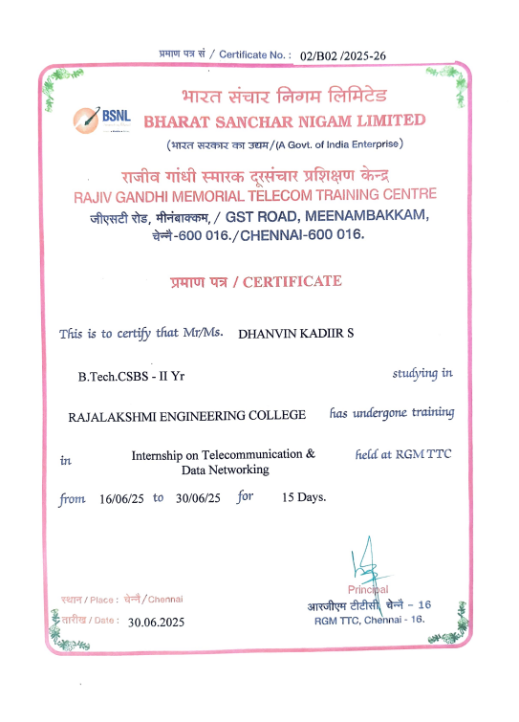
Internship certificate

